Slide 1
Build and Modernize AI Apps With Azure Cosmos DB
Patrice Truong, Sr. Technology Specialist, Data & AI
patrice.truong@microsoft.com
Emmanuel Deletang, Sr. Global Black Belt, Data
emmanuel.deletang@microsoft.com
Richard Prade, Cloud Solution Architect, Data &AI
richard.prade@microsoft.com
Ryad Ben Salah, Cloud Solution Architect, Data & AI
ryad.bensalah@microsoft.com

Slide 2

Workshop Environment
AI
Data
Apps
Azure Cosmos DB for MongoDB vCore
Azure Cosmos DB for NoSQL
Azure AI Search
Relational
GPT 3.5 Turbo
Text-embedding-ada-002
Visual Studio Code
Python
Streamlit

Slide 3
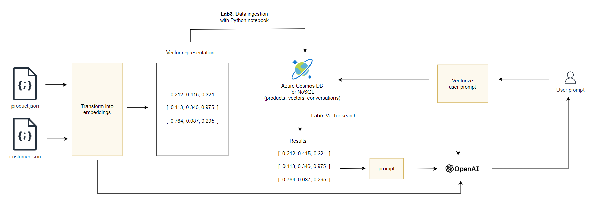
Labs Overview Build a RAG system

Slide 4
Labs
Lab 1 - Azure Cosmos DB for MongoDB vCore
Lab 2 - Azure Cosmos DB for NoSQL
Lab 3 – Data ingestion into Azure Cosmos DB for MongoDB vCore
Lab 4 – Create a web app using Azure AI Studio
Lab 5 – Create a Python chatbot
Lab 6 – Hybrid search with Azure AI Search
Lab 7 – Get statistics on the Open AI Usage

Slide 5
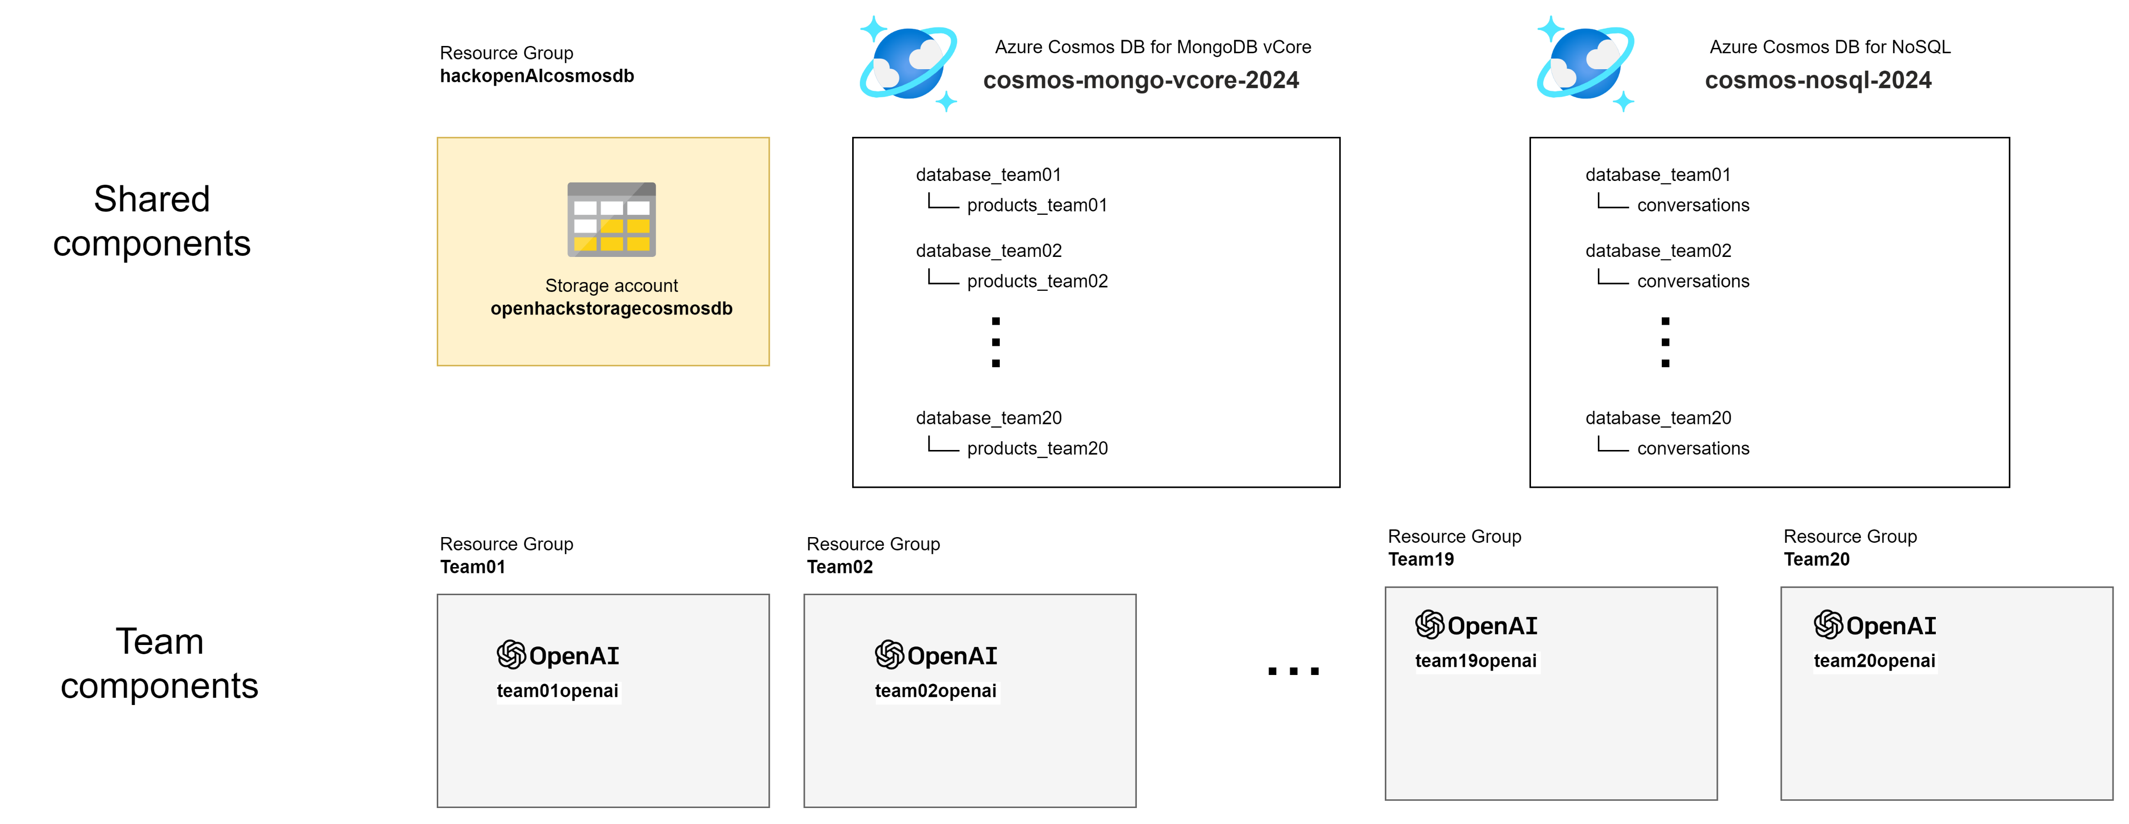
Shared Azure Subscription

Slide 6
Software pre-requisites https://openhackstoragecosmosdb.blob.core.windows.net/software
Visual Studio Code https://code.visualstudio.com/download
Python 3.10.11 https://www.python.org/downloads/release/python-31011/
Visual C++ build tools https://visualstudio.microsoft.com/vs/features/cplusplus/

Slide 7
Passwords
MSGuest WiFi password:
Click on "Event Attendee Code"
msevent1407
Azure account:
Connect in private mode: portal.azure.com
teamXX@hackcosmosdbgmail.onmicrosoft.com Hack12/34cosmosdb

